Slide 1
Microsoft Visual C#: An Introduction to Object-Oriented Programming
7th Edition
Chapter 7
Using Methods
© 2018 Cengage. All Rights Reserved. May not be copied, scanned, or duplicated, in whole or in part, except for use as permitted in a license distributed with a certain product or service or otherwise on a password-protected website for classroom use.

Slide 2
Objectives (1 of 2)
7.1 Understand methods and implementation hiding
7.2 Write methods with no parameters and no return value
7.3 Write methods that require a single argument
7.4 Write methods that require multiple arguments
7.5 Write methods that return a value
© 2018 Cengage. May not be copied, scanned, or duplicated, in whole or in part, except for use as permitted in a license distributed with a certain product or service or otherwise on a password-protected website for classroom use.

Slide 3
Objectives (2 of 2)
7.6 Pass array values to a method
7.7 Understand some alternate ways to write a Main() method header
7.8 Appreciate issues using methods in GUI programs
© 2018 Cengage. May not be copied, scanned, or duplicated, in whole or in part, except for use as permitted in a license distributed with a certain product or service or otherwise on a password-protected website for classroom use.

Slide 4
Understanding Methods and Implementation Hiding (1 of 2)
Method
An encapsulated series of statements that carry out a task
Frequently, the methods you have written have invoked, or called, other methods
That is, your program used a method’s name and the method executed to perform a task for the class
© 2018 Cengage. May not be copied, scanned, or duplicated, in whole or in part, except for use as permitted in a license distributed with a certain product or service or otherwise on a password-protected website for classroom use.

Slide 5
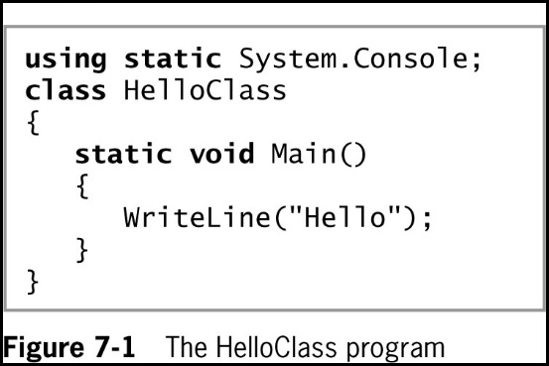
Understanding Methods and Implementation Hiding (2 of 2)
In the HelloClass program in Figure 7-1:
Main() is a calling method – one that calls another
WriteLine() method is a called method
© 2018 Cengage. May not be copied, scanned, or duplicated, in whole or in part, except for use as permitted in a license distributed with a certain product or service or otherwise on a password-protected website for classroom use.

Slide 6
Understanding Implementation Hiding
Implementation hiding
An important principle of object-oriented programming
Keeps the details of a method’s operations hidden
The only concern is the way you interface, or interact, with the method
The program does not need to know how the method works
A method that uses another is a client of that method
Methods exist in a black box – a virtual device you can use without knowing how it works internally
© 2018 Cengage. May not be copied, scanned, or duplicated, in whole or in part, except for use as permitted in a license distributed with a certain product or service or otherwise on a password-protected website for classroom use.

Slide 7
Writing Methods with No Parameters and No Return Value (1 of 3)
Major reasons to create a method:
The code will remain short and easy to follow
A method is easily reusable
Code bloat
Unnecessarily long or repetitive statements
A method must include:
Method declaration, which is also called a method header or method definition
Opening curly brace {
Method body, which is a block of statements that carry out the method’s work
Closing curly brace }
© 2018 Cengage. May not be copied, scanned, or duplicated, in whole or in part, except for use as permitted in a license distributed with a certain product or service or otherwise on a password-protected website for classroom use.

Slide 8
Writing Methods with No Parameters and No Return Value (2 of 3)
Method declaration - defines the rules for using the method and contains:
Optional declared accessibility
Optional static modifier
Return type for the method
Method name, or identifier
Opening parenthesis
Optional list of method parameters
Closing parenthesis
© 2018 Cengage. May not be copied, scanned, or duplicated, in whole or in part, except for use as permitted in a license distributed with a certain product or service or otherwise on a password-protected website for classroom use.

Slide 9
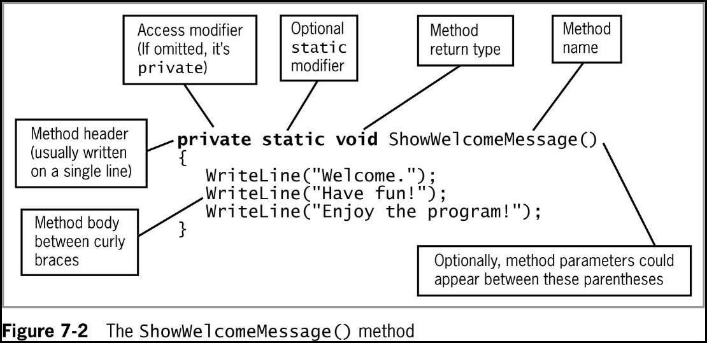
Writing Methods with No Parameters and No Return Value (3 of 3)
© 2018 Cengage. May not be copied, scanned, or duplicated, in whole or in part, except for use as permitted in a license distributed with a certain product or service or otherwise on a password-protected website for classroom use.

Slide 10
An Introduction to Accessibility (1 of 2)
Optional declared accessibility
Limits how other methods can use your method
Possible access values:
Public access – established by including a public modifier in the member declaration (allows access to the method from other classes)
Private Access - is established by including a private modifier in the member declaration or by omitting any accessibility modifier
This modifier limits method access to the class that contains the method
© 2018 Cengage. May not be copied, scanned, or duplicated, in whole or in part, except for use as permitted in a license distributed with a certain product or service or otherwise on a password-protected website for classroom use.

Slide 11
An Introduction to Accessibility (2 of 2)
If you do not provide an accessibility modifier for a method
It is private by default
When you use a method’s complete name, including its class, you are using its fully qualified name
E.g. System.Console.WriteLine()
© 2018 Cengage. May not be copied, scanned, or duplicated, in whole or in part, except for use as permitted in a license distributed with a certain product or service or otherwise on a password-protected website for classroom use.

Slide 12
An Introduction to the Optional static Modifier
You can declare a method to be static or nonstatic
Methods are nonstatic by default
static method
Can be called without referring to an object
Instead, you refer to the class
Cannot call nonstatic methods
nonstatic method
The default
Can be used only in conjunction with an object
Nonstatic methods can call static ones
© 2018 Cengage. May not be copied, scanned, or duplicated, in whole or in part, except for use as permitted in a license distributed with a certain product or service or otherwise on a password-protected website for classroom use.

Slide 13
An Introduction to Return Types
Every method has a return type
Indicates what kind of value the method will return to any other method that calls it
If a method does not return a value, its return type is void
A method’s return type is known more succinctly as a method’s type
© 2018 Cengage. May not be copied, scanned, or duplicated, in whole or in part, except for use as permitted in a license distributed with a certain product or service or otherwise on a password-protected website for classroom use.

Slide 14
Understanding the Method Identifier
The method name must be a legal C# identifier
Parameter to a method
A variable that holds data passed to a method when it is called
The parentheses that follow a method name in its header can hold one parameter or multiple parameters separated with commas
The contents within the parentheses are known as the parameter list
© 2018 Cengage. May not be copied, scanned, or duplicated, in whole or in part, except for use as permitted in a license distributed with a certain product or service or otherwise on a password-protected website for classroom use.

Slide 15
Placing a Method in a Class (1 of 3)
By convention, programmers indent the statements in a method body
Makes the method header and its braces stand out
Methods cannot overlap
Usually you want to place methods one after the other within a class
The order that methods appear in a class is not important
It is only the order in which they are called that affects how they execute
© 2018 Cengage. May not be copied, scanned, or duplicated, in whole or in part, except for use as permitted in a license distributed with a certain product or service or otherwise on a password-protected website for classroom use.

Slide 16
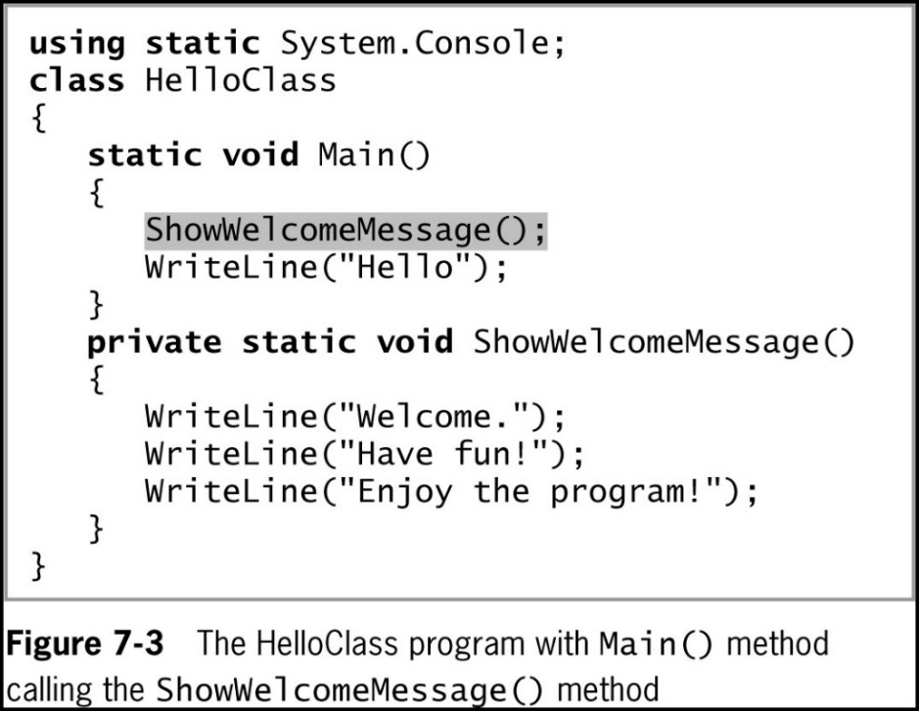
Placing a Method in a Class (2 of 3)
Local function
When a method resides entirely within another method
It can be called only from its containing method and not from any other methods
© 2018 Cengage. May not be copied, scanned, or duplicated, in whole or in part, except for use as permitted in a license distributed with a certain product or service or otherwise on a password-protected website for classroom use.

Slide 17
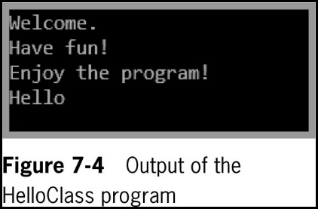
Placing a Method in a Class (3 of 3)
© 2018 Cengage. May not be copied, scanned, or duplicated, in whole or in part, except for use as permitted in a license distributed with a certain product or service or otherwise on a password-protected website for classroom use.

Slide 18
Declaring Variables and Constants in a Method (1 of 3)
Variables and constants can be declared in a method
In scope only from the point at which they are declared to the end of the method
Scope
The area in which a variable is known
Programmers say that the area in which an item can be used is the area in which it is visible
They are considered local to that method
Their scope is defined by the boundaries of the method
They are not accessible outside of the method except when passed as parameters to other methods
© 2018 Cengage. May not be copied, scanned, or duplicated, in whole or in part, except for use as permitted in a license distributed with a certain product or service or otherwise on a password-protected website for classroom use.

Slide 19
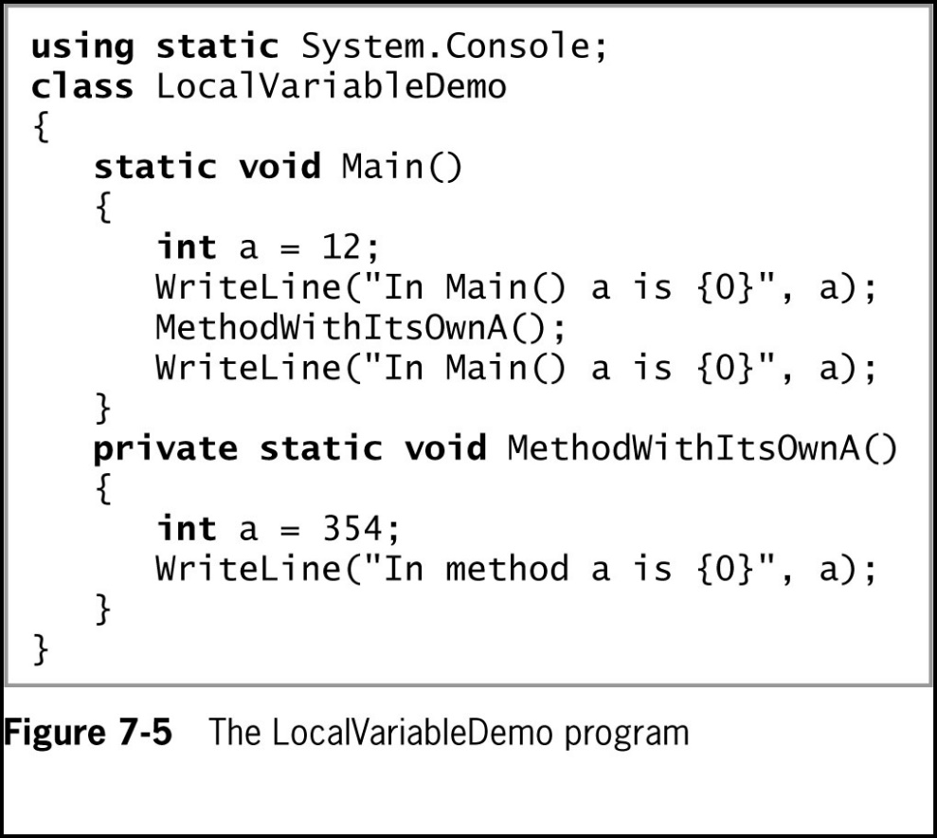
Declaring Variables and Constants in a Method (2 of 3)
© 2018 Cengage. May not be copied, scanned, or duplicated, in whole or in part, except for use as permitted in a license distributed with a certain product or service or otherwise on a password-protected website for classroom use.

Slide 20
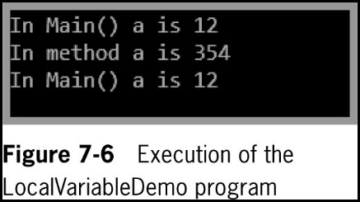
Declaring Variables and Constants in a Method (3 of 3)
© 2018 Cengage. May not be copied, scanned, or duplicated, in whole or in part, except for use as permitted in a license distributed with a certain product or service or otherwise on a password-protected website for classroom use.

Slide 21
Writing Methods That Require a Single Argument (1 of 3)
When you write the declaration for a method that accepts a parameter, you need to include the following items within the method declaration parentheses:
The type of the parameter
A local identifier (name) for the parameter
Local variable
Declared within a method
Formal parameter
A parameter in a method header that accepts a value
Actual parameters
Arguments within a method call
© 2018 Cengage. May not be copied, scanned, or duplicated, in whole or in part, except for use as permitted in a license distributed with a certain product or service or otherwise on a password-protected website for classroom use.

Slide 22
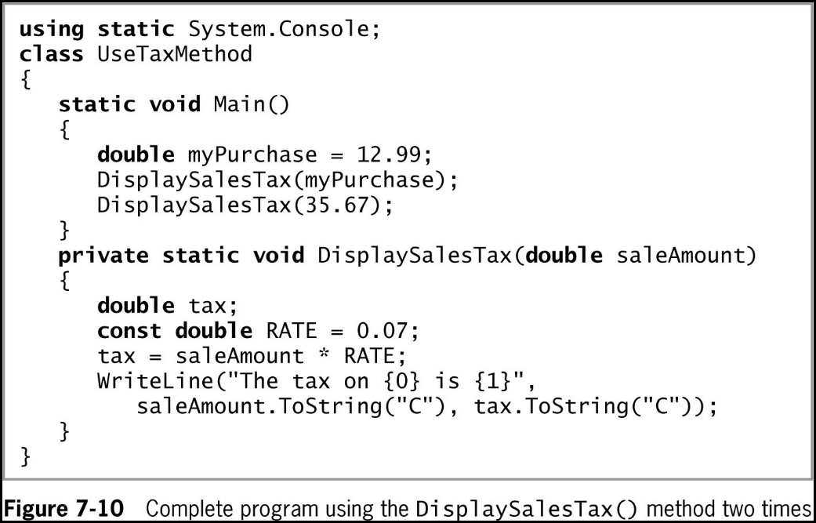
Writing Methods That Require a Single Argument (2 of 3)
© 2018 Cengage. May not be copied, scanned, or duplicated, in whole or in part, except for use as permitted in a license distributed with a certain product or service or otherwise on a password-protected website for classroom use.

Slide 23
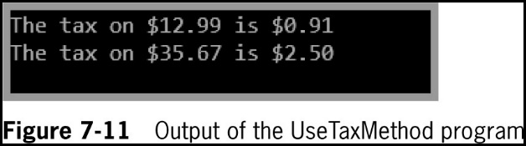
Writing Methods That Require a Single Argument (3 of 3)
© 2018 Cengage. May not be copied, scanned, or duplicated, in whole or in part, except for use as permitted in a license distributed with a certain product or service or otherwise on a password-protected website for classroom use.

Slide 24
Writing Methods That Require Multiple Arguments (1 of 2)
Methods can take any number of parameters in any order
When you call the method, arguments must match (in number and type) the parameters listed in the method declaration, with the following exceptions:
The type of an argument does not need to match the parameter list exactly if the argument can be promoted to the parameter type
The number of arguments does not need to match the number in the parameter list when you use default arguments
© 2018 Cengage. May not be copied, scanned, or duplicated, in whole or in part, except for use as permitted in a license distributed with a certain product or service or otherwise on a password-protected website for classroom use.

Slide 25
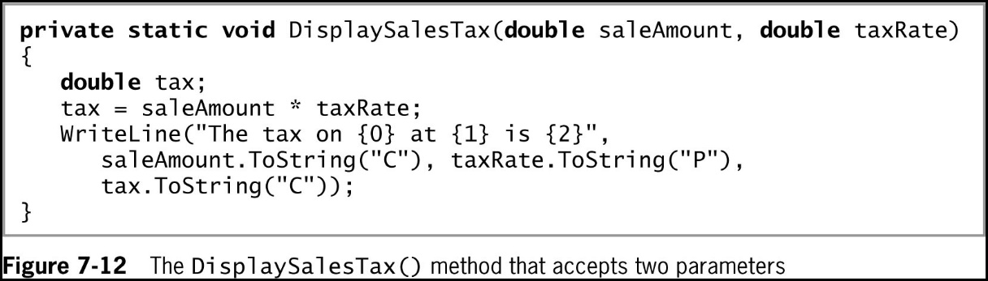
Writing Methods That Require Multiple Arguments (2 of 2)
© 2018 Cengage. May not be copied, scanned, or duplicated, in whole or in part, except for use as permitted in a license distributed with a certain product or service or otherwise on a password-protected website for classroom use.

Slide 26
Writing Methods That Return a Value (1 of 4)
A method can return, at most, one value to a method that calls it
Method’s type
A method’s return type
return statement
Causes a value to be sent back to the calling method
You are not required to use a returned value
© 2018 Cengage. May not be copied, scanned, or duplicated, in whole or in part, except for use as permitted in a license distributed with a certain product or service or otherwise on a password-protected website for classroom use.

Slide 27
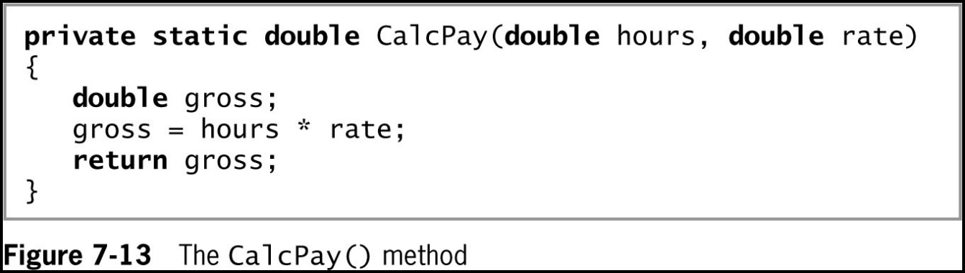
Writing Methods That Return a Value (2 of 4)
Suppose you want to create a method to accept the hours an employee worked and the hourly pay rate, and to return a calculated gross pay:
© 2018 Cengage. May not be copied, scanned, or duplicated, in whole or in part, except for use as permitted in a license distributed with a certain product or service or otherwise on a password-protected website for classroom use.

Slide 28
Writing Methods That Return a Value (3 of 4)
A returned value can be:
Stored in a variable
Used directly
Nested method calls
Method calls placed inside other method calls
Writing a method that returns a Boolean value
When a method returns a value that is type bool, the method call can be used anywhere you can use a Boolean expression
Branching statements (e.g., if(…))
Loop control variables
© 2018 Cengage. May not be copied, scanned, or duplicated, in whole or in part, except for use as permitted in a license distributed with a certain product or service or otherwise on a password-protected website for classroom use.

Slide 29
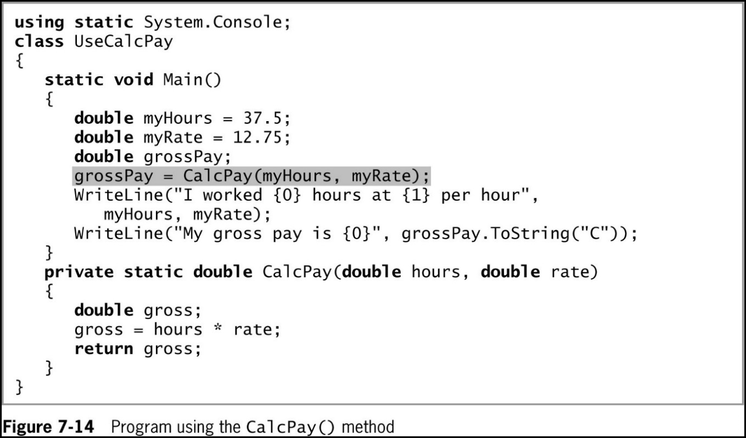
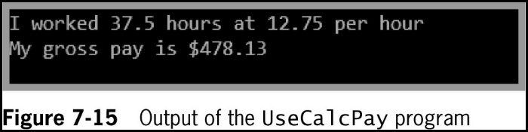
Writing Methods That Return a Value (4 of 4)
© 2018 Cengage. May not be copied, scanned, or duplicated, in whole or in part, except for use as permitted in a license distributed with a certain product or service or otherwise on a password-protected website for classroom use.

Slide 30
Writing a Method That Returns a Boolean Value
Methods can return a value that is type bool
Makes for more readable if statements
E.g. A method named isPreferredCustomer() that returns a Boolean value indicating whether a customer is a preferred customer who qualifies for a discount\
If statement can be written as:
if (isPreferredCustomer())
price = price − DISCOUNT;
When using Boolean methods, you must be careful not to cause unintended side effects
© 2018 Cengage. May not be copied, scanned, or duplicated, in whole or in part, except for use as permitted in a license distributed with a certain product or service or otherwise on a password-protected website for classroom use.

Slide 31
Analyzing a Built-In Method
Prewritten Methods
E.g. Pow()- raises a number to a power
double result = Math.Pow(2.0, 3.0);
From this statement, you know the following about the Pow() method:
It is in the Math class because the class name and a dot precede the method call
It is public because you can write a program that uses it
It is static because it is used with its class name and a dot, without any object
It accepts two double parameters
It returns a double or a type that can be promoted automatically to a double (such as an int) because its answer is stored in a double
© 2018 Cengage. May not be copied, scanned, or duplicated, in whole or in part, except for use as permitted in a license distributed with a certain product or service or otherwise on a password-protected website for classroom use.

Slide 32
Passing Array Values to a Method
Passing an array element to a method and passing an array to a method require different approaches
© 2018 Cengage. May not be copied, scanned, or duplicated, in whole or in part, except for use as permitted in a license distributed with a certain product or service or otherwise on a password-protected website for classroom use.

Slide 33
Passing a Single Array Element to a Method (1 of 3)
You can pass a single array element to a method in the same manner as you would pass a variable
Variables are passed by value
Local variables store a local copy of the value
© 2018 Cengage. May not be copied, scanned, or duplicated, in whole or in part, except for use as permitted in a license distributed with a certain product or service or otherwise on a password-protected website for classroom use.

Slide 34
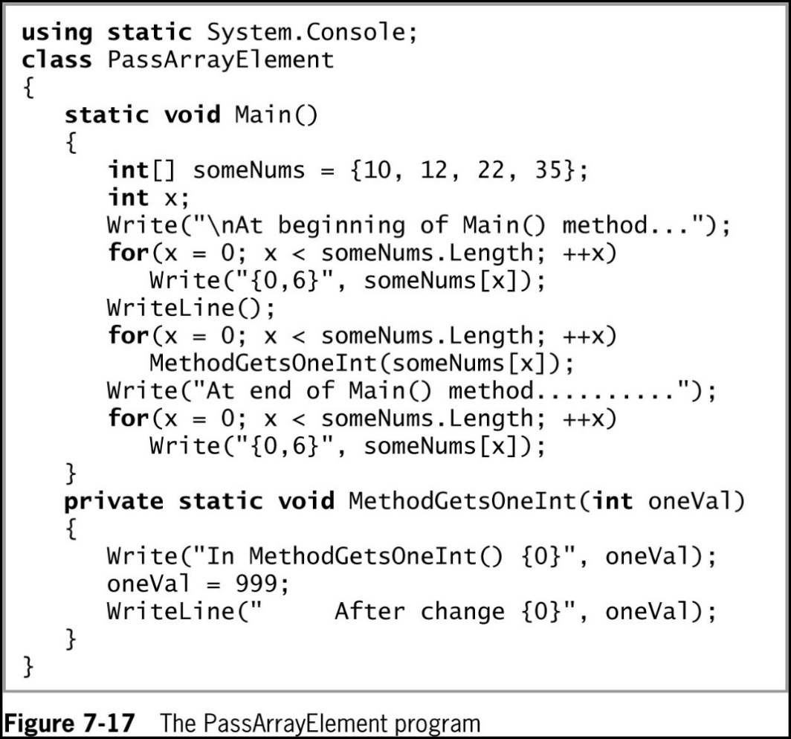
Passing a Single Array Element to a Method (2 of 3)
© 2018 Cengage. May not be copied, scanned, or duplicated, in whole or in part, except for use as permitted in a license distributed with a certain product or service or otherwise on a password-protected website for classroom use.

Slide 35
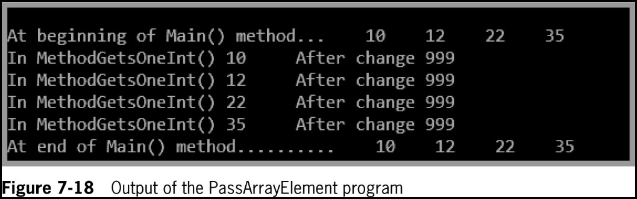
Passing a Single Array Element to a Method (3 of 3)
© 2018 Cengage. May not be copied, scanned, or duplicated, in whole or in part, except for use as permitted in a license distributed with a certain product or service or otherwise on a password-protected website for classroom use.

Slide 36
Passing an Array to a Method (1 of 4)
You can pass an entire array as a parameter
A memory address is also known as a reference
Arrays, like all objects but unlike built-in types, are passed by reference
The method receives the actual memory address of the array
Has access to the actual values in the array elements
© 2018 Cengage. May not be copied, scanned, or duplicated, in whole or in part, except for use as permitted in a license distributed with a certain product or service or otherwise on a password-protected website for classroom use.

Slide 37
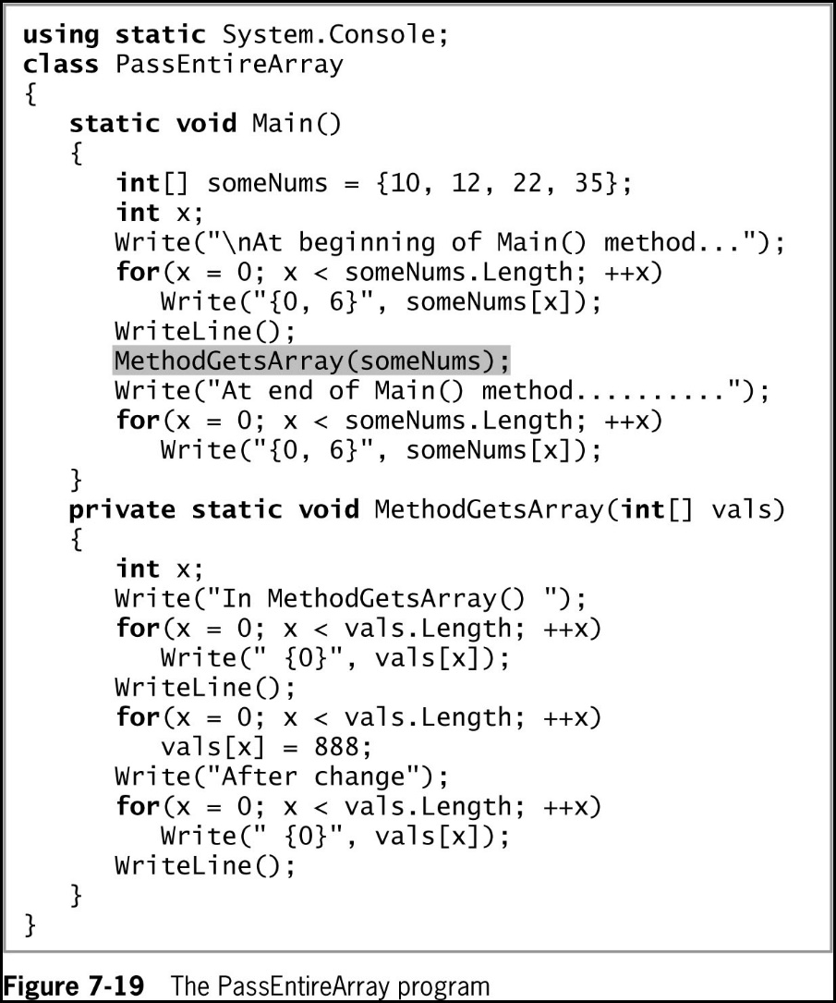
Passing an Array to a Method (2 of 4)
© 2018 Cengage. May not be copied, scanned, or duplicated, in whole or in part, except for use as permitted in a license distributed with a certain product or service or otherwise on a password-protected website for classroom use.

Slide 38
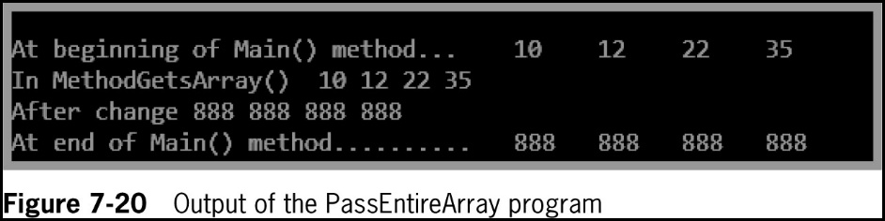
Passing an Array to a Method (3 of 4)
© 2018 Cengage. May not be copied, scanned, or duplicated, in whole or in part, except for use as permitted in a license distributed with a certain product or service or otherwise on a password-protected website for classroom use.

Slide 39
Passing an Array to a Method (4 of 4)
You can pass a multidimensional array to a method by indicating the appropriate number of dimensions after the data type in the method header
Example
private static void displayScores(int[,] scoresArray)
Jagged arrays insert the appropriate number of square brackets after the data type in the method header
Example
private static void displayIDs(int[ ][ ] idArray)
© 2018 Cengage. May not be copied, scanned, or duplicated, in whole or in part, except for use as permitted in a license distributed with a certain product or service or otherwise on a password-protected website for classroom use.

Slide 40
Alternate Ways to Write a Main() Method Header
Throughout this book, you have written Main() methods with the following header:
static void Main()
This section describes alternatives because you might see different Main() method headers in other books or in programs written by others
© 2018 Cengage. May not be copied, scanned, or duplicated, in whole or in part, except for use as permitted in a license distributed with a certain product or service or otherwise on a password-protected website for classroom use.

Slide 41
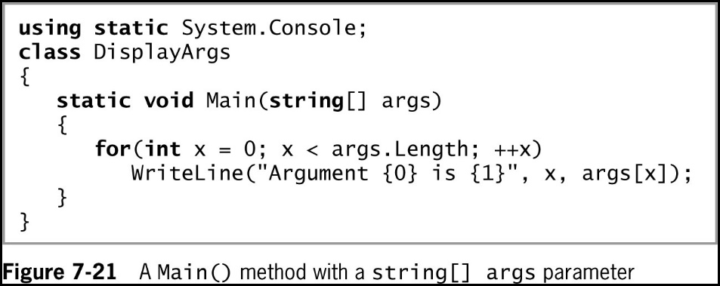
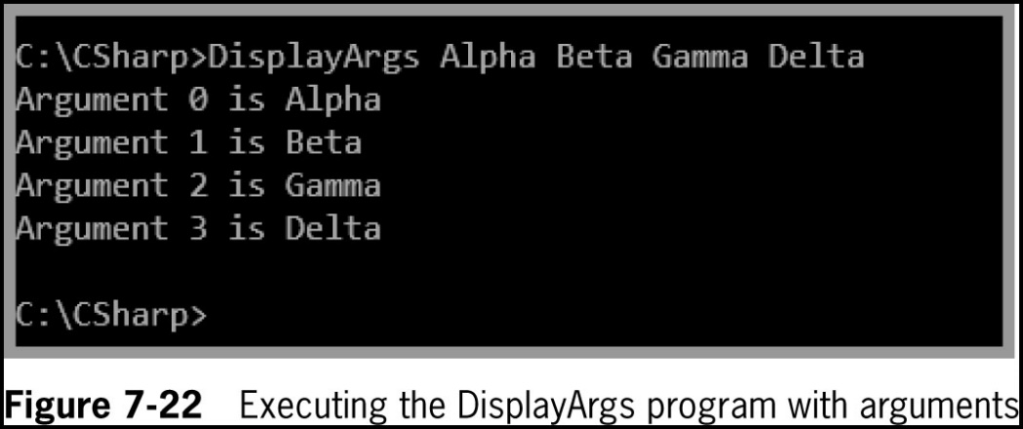
Writing a Main() Method with a Parameter List
© 2018 Cengage. May not be copied, scanned, or duplicated, in whole or in part, except for use as permitted in a license distributed with a certain product or service or otherwise on a password-protected website for classroom use.

Slide 42
Writing a Main() Method with an Integer Return Type
Some programmers prefer to write Main() method headers with a return type of int instead of void
The last statement in the Main() method must be a return statement
A return code of 0 indicates a successful execution
Any other value can be interpreted as an error code
© 2018 Cengage. May not be copied, scanned, or duplicated, in whole or in part, except for use as permitted in a license distributed with a certain product or service or otherwise on a password-protected website for classroom use.

Slide 43
Writing a Main() Method with public Access
Some programmers prefer to write Main() method headers with public access
The default is private access
A public Main() method can be called by another class
The call must be made using the fully qualified name
© 2018 Cengage. May not be copied, scanned, or duplicated, in whole or in part, except for use as permitted in a license distributed with a certain product or service or otherwise on a password-protected website for classroom use.

Slide 44
Issues Using Methods in GUI Programs
Some special considerations are necessary when creating GUI applications
Understanding methods that are automatically generated in the visual environment
Appreciating scope in a GUI program
Creating methods to be nonstatic when associated with a Form
© 2018 Cengage. May not be copied, scanned, or duplicated, in whole or in part, except for use as permitted in a license distributed with a certain product or service or otherwise on a password-protected website for classroom use.

Slide 45
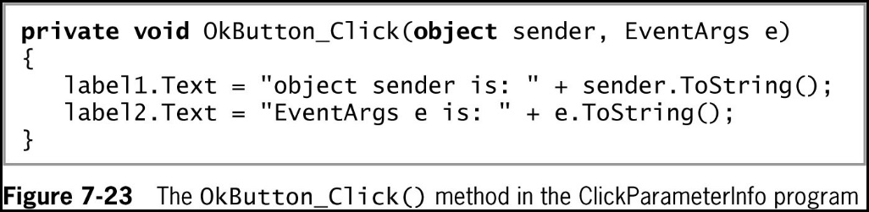
Understanding Methods That Are Generated Automatically in the Visual Environment (1 of 2)
When you create GUI applications using the IDE, many methods are generated automatically
To create the method, double-click on the object
© 2018 Cengage. May not be copied, scanned, or duplicated, in whole or in part, except for use as permitted in a license distributed with a certain product or service or otherwise on a password-protected website for classroom use.

Slide 46
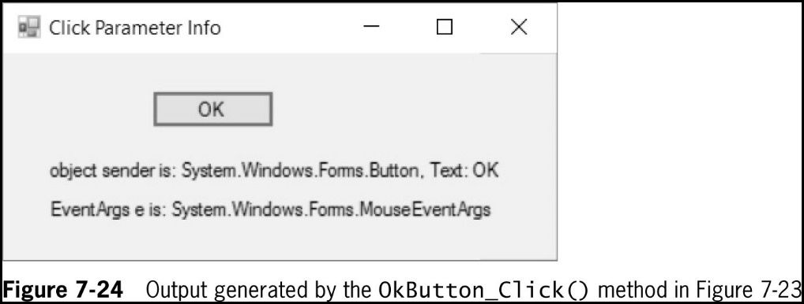
Understanding Methods That Are Generated Automatically in the Visual Environment (2 of 2)
© 2018 Cengage. May not be copied, scanned, or duplicated, in whole or in part, except for use as permitted in a license distributed with a certain product or service or otherwise on a password-protected website for classroom use.

Slide 47
Appreciating Scope in a GUI Program
When you declare a variable or constant within a method, it is local to that method
If a variable or constant is needed by multiple event-handling methods, the variables or constants in question must be defined outside the methods (but within the Form class)
Automatically generated event-handling methods have predefined sets of parameters
© 2018 Cengage. May not be copied, scanned, or duplicated, in whole or in part, except for use as permitted in a license distributed with a certain product or service or otherwise on a password-protected website for classroom use.

Slide 48
Creating Methods to be Nonstatic When Associated with a Form
When you create a GUI application and generate a method, the keyword static does not appear in the method header
The method is associated with an object from which the method-invoking events are sent
© 2018 Cengage. May not be copied, scanned, or duplicated, in whole or in part, except for use as permitted in a license distributed with a certain product or service or otherwise on a password-protected website for classroom use.

Slide 49
Chapter Summary (1 of 2)
A method is a series of statements that perform a task
Object-oriented programs hide their methods’ implementation
You write methods to make programs easier to understand, and so that you can easily reuse them
Some methods require passed-in information called arguments or parameters
You can pass multiple arguments to a method
© 2018 Cengage. May not be copied, scanned, or duplicated, in whole or in part, except for use as permitted in a license distributed with a certain product or service or otherwise on a password-protected website for classroom use.

Slide 50
Chapter Summary (2 of 2)
The return type for a method can be any type used in the C# programming language
You can pass an array as a parameter to a method
You might see different Main() method headers in other books or in programs written by others
Special considerations exist for methods when you create GUI applications
© 2018 Cengage. May not be copied, scanned, or duplicated, in whole or in part, except for use as permitted in a license distributed with a certain product or service or otherwise on a password-protected website for classroom use.

